Slide 1
AGENDA
Scope of This Review
Requirements (Functional & Non-Functional)
Detailed System Architecture
Use Case & ER Diagrams
Module Description & Tech Stack
UI Design, Frontend & Backend Build
Database & API Integration
Progress (70%), Screenshots & Challenges
Agenda
Review 1 & 2 | MERN Stack Project

Slide 2
01
REQUIREMENTS
Functional & Non-Functional Requirements
Functional Requirements
Non-Functional Requirements
▪User Registration & Authentication
▪ Role-Based Access & Dashboards
▪ Patient Record Management
▪ Health Data Monitoring
▪ AI-Based Health Assistance
▪ REST API & CRUD Operations
▪ Alerts & Notifications
▪ Performance & Responsiveness
▪ Security & Data Privacy
▪ Scalability
▪ Reliability & Availability
▪ User-Friendly Interface
▪ Modular & Maintainable Architecture
Requirements
Review 1 & 2 | MERN Stack Project

Slide 3
APPLICATION TIER
02
ARCHITECTURE
Node.js + Express.js
REST APIs
Authentication
Business Logic
System Architecture (Detailed)
CLIENT TIER
APPLICATION TIER
AI SERVICE
DATA TIER
⇄
Node.js + Express.js
REST APIs
Authentication
Business Logic
⇄
⇄
React.js
Axios
Responsive UI
User Interaction
AI Processing
Health Analysis
AI API Communication
MongoDB + Mongoose
Collections & Schemas
Client requests are sent to the Express backend through REST APIs. The backend manages authentication, business logic and database operations, while the AI service handles AI-based processing and returns results to the application..
Architecture
Review 1 & 2 | MERN Stack Project

Slide 4
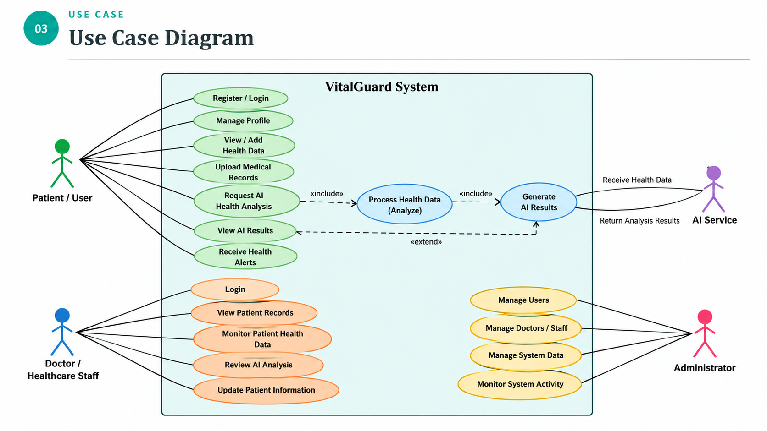
03
USE CASE
Use Case Diagram
Use Case
Review 1 & 2 | MERN Stack Project

Slide 5
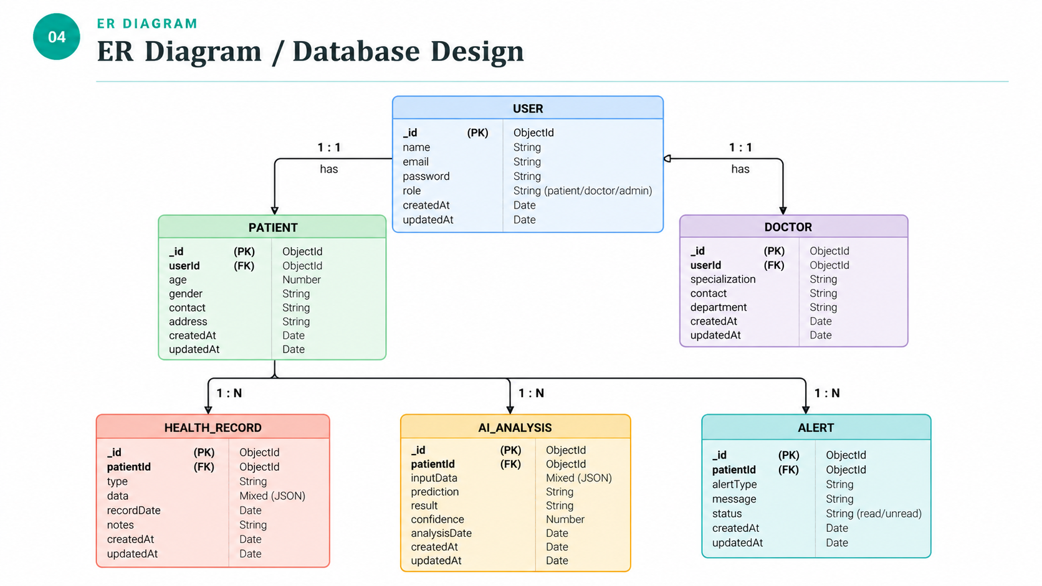
04
ER DIAGRAM
ER Diagram / Database Design
ER Diagram
Review 1 & 2 | MERN Stack Project

Slide 6
05
MODULES
Module Description
Module | Description | Key Functions
User Management | Registration, login & role handling | Signup, Login, Authentication
Patient Management | Manage patient health information | Create, View, Update
Doctor Management | Monitor and manage patient records | View, Monitor, Manage
AI Health Service | AI-based health data processing | Analysis, Prediction, Results
Admin & Notifications | System management and alerts | User Management, Alerts
Modules
Review 1 & 2 | MERN Stack Project

Slide 7
06
TECH STACK
Technology Stack
MongoDB
Express.js
React.js
Node.js
NoSQL Database
Backend Framework
Frontend Library
Runtime Environment
Supporting Tools
Mongoose (ODM)
JWT & bcrypt (auth/security)
Postman (API testing)
Git & GitHub (version control)
VS Code, npm
Axios (HTTP client)
Tech Stack
Review 1 & 2 | MERN Stack Project

Slide 8
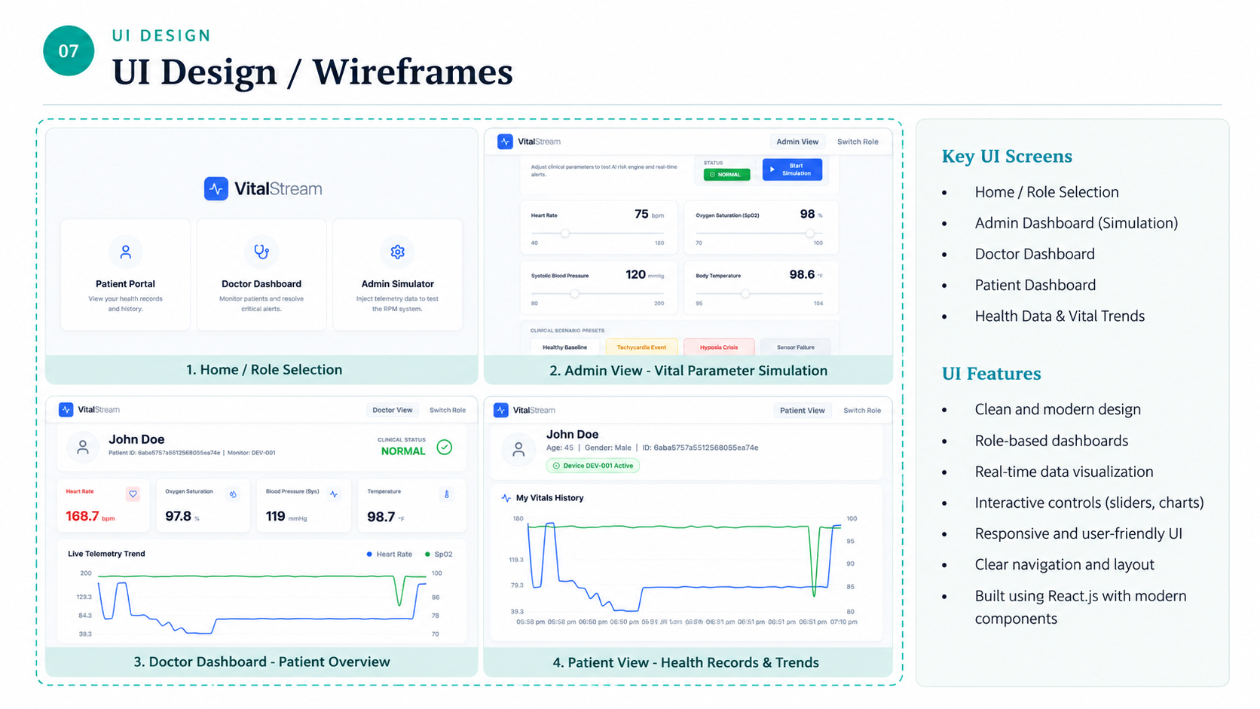
07
UI DESIGN
UI Design / Wireframes
UI Design
Review 1 & 2 | MERN Stack Project

Slide 9
08
FRONTEND
Frontend Development
React.js with reusable and modular components
Role-based dashboards for Patient, Doctor & Admin
Interactive health monitoring with real-time vital data
Charts and visualizations for health trends
REST API integration using Axios
Responsive and user-friendly UI
Interactive alerts and status indicators
Frontend
Review 1 & 2 | MERN Stack Project

Slide 10
09
BACKEND
Backend Development
Node.js + Express.js server with modular routes
MVC architecture for routes, controllers & models
JWT authentication and protected APIs
Input validation & error handling
Environment configuration using .env
REST APIs tested with Postman
Backend
Review 1 & 2 | MERN Stack Project

Slide 11
10
DATABASE
Database Integration
MongoDB used as the primary data store
Mongoose schemas for structured data management
Patient and health data stored and managed efficiently
CRUD operations integrated with the backend APIs
Sample data used for development and testing
Secure and scalable database design
Database
Review 1 & 2 | MERN Stack Project

Slide 12
11
API
API Development
Method | Endpoint | Description
POST | /api/auth/register | Register a new user
POST | /api/auth/login | Authenticate user
GET | /api/patients | Retrieve patient data
GET | /api/vitals/:patientId | Retrieve patient vital history
POST | /api/vitals | Store new vital readings
GET | /api/alerts | Retrieve health alerts
API
Review 1 & 2 | MERN Stack Project

Slide 13
12
STATUS
Module-wise Implementation Status
User Authentication
100%
Frontend UI (Core Screens)
80%
Backend APIs
75%
Database Integration
70%
Admin Module
50%
Notifications
30%
Status
Review 1 & 2 | MERN Stack Project

Slide 14
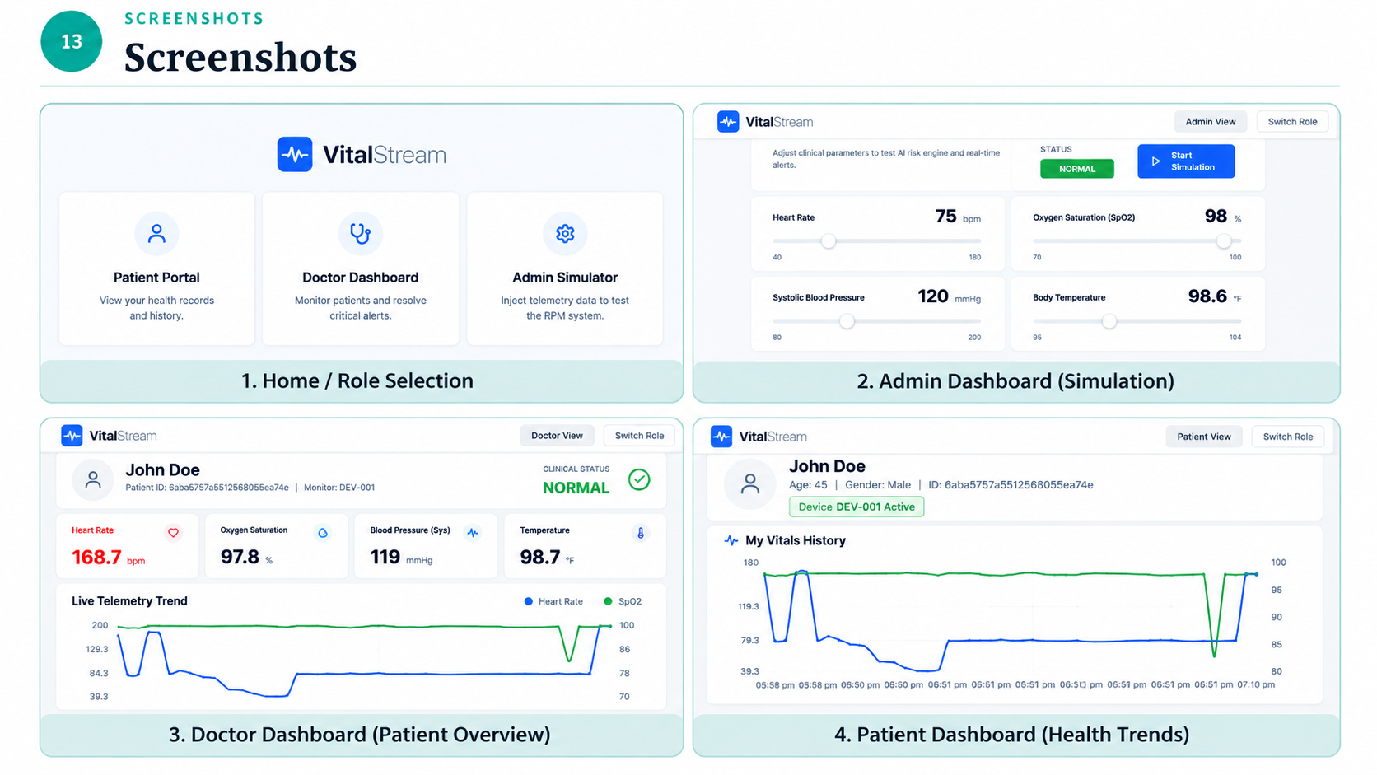
13
SCREENSHOTS
Screenshots
Screenshots
Review 1 & 2 | MERN Stack Project

Slide 15
14
CHALLENGES
Challenges Faced & Solutions
Challenge | Solution Adopted
Frontend–backend API integration | Configured REST APIs and Axios communication
Real-time vital data synchronization | Implemented dynamic state updates and telemetry handling
Role-based dashboard management | Separated Patient, Doctor and Admin workflows
MongoDB data management | Used Mongoose schemas and CRUD operations
Challenges
Review 1 & 2 | MERN Stack Project

Slide 16
15
NEXT STEPS
Remaining Work & Plan
Complete Admin Module and analytics features
Implement Notifications & Health Alerts
Complete AI Health Analysis integration
Perform API, integration & user testing
Improve UI responsiveness and accessibility
Deploy the application and database
Prepare final documentation and project demo
Next Steps
Review 1 & 2 | MERN Stack Project

Slide 17
16
NEXT STEPS
References
# | Reference
1 | MongoDB, Express.js, React.js & Node.js — Official Documentation
2 | React & Node.js — Official Documentation
3 | Mongoose — Official Documentation
4 | JWT & Axios — Official Documentation
Next Steps
Review 1 & 2 | MERN Stack Project

